Slide 1
Storage devices we use everyday

Slide 2
Digital data storage
Digital data storage is essentially the recording of digital information in a storage medium, typically by electronic means. The storage device usually enables a user to store large amounts of data in a relatively small physical space, and makes sharing that information with others easy. The device may be capable of holding the data either temporarily or permanently.
Digital data storage devices have many uses. For example, computers usually depend upon information storage to function. Storage media can also be used to back up important information (storing digital data can involve durability and reliability issues, so making independent copies of the information is normally a wise precaution). Some storage devices are also portable, meaning that they can be used to transfer information from one computer to another.

Slide 3
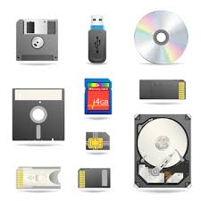
Digital data storage

Slide 4
. .Hard Disk Drive
A hard disk drive (also known as a hard drive, HD, or HDD) can be found installed in almost every desktop computer and laptop. It stores files for the operating system and software programs, as well as user documents, such as photographs, text files, and audio. The hard drive uses magnetic storage to record and retrieve digital information to and from one or more fast-spinning disks.

Slide 5
Solid State Drive (SSD)
A solid state drive uses flash memory to store data and is sometimes used in devices such as netbooks, laptop, and desktop computers instead of a traditional hard disk drive. The advantages of an SSD over a HDD include a faster read/write speed, noiseless operation, greater reliability, and lower power consumption. The biggest downside is cost, with an SSD offering lower capacity than an equivalently priced HDD.

Slide 6
3. Cloud Storage
Cloud computing basically involves accessing services over a network via a collection of remote servers. Enough to have internet access.

Slide 7
Compact Disc
The compact disc, known for short as a CD, is a form of optical storage, a technology which employs lasers and lights to read and write data. Initially compact discs were used purely for music audio, but in the late 1980's they began to be also used for computer data storage.
Initially, the compact discs that were introduced were CD-ROM's (read only), but this was followed by CD-R's (writable compact discs) and CD-RW's (re-writable compact discs).

Slide 8
DVD and Blu-ray Discs
The DVD (digital versatile disc) and Blu-ray disc (BD) are formats of digital optical disc data storage which have superseded compact discs, mainly because of their much greater storage capacity.

Slide 9
USB Flash Drive
Thumb drive, pen drive, flash-drive, memory stick, jump drive, and USB stick, the USB flash drive is a flash memory data storage device that incorporates an integrated USB interface. Flash memory is generally more efficient and reliable than optical media, being smaller, faster(not always), and possessing much greater storage capacity, as well as being more durable due to a lack of moving parts.

Slide 10

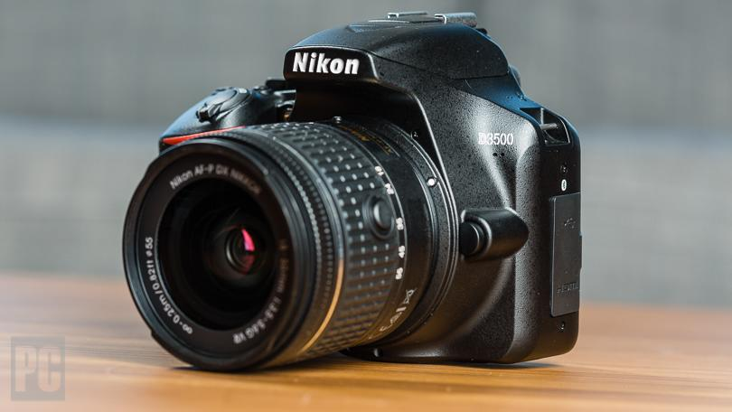
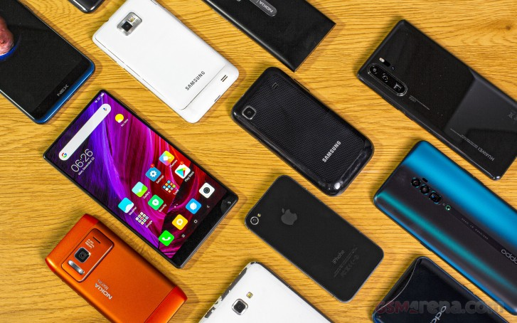
Secure Digital Card (SD Card)
A common type of memory card, SD cards are used in multiple electronic devices, including digital cameras and mobile phones.

Slide 11
Bonus - Paper
Paper is one of the oldest storage devices.
Thanks for watching

